Slide 1
Network Layer: IP Addressing
Dr. Uttam Ghosh
Computer Science
Vanderbilt University

Slide 2

Network Layer Protocols

Slide 3
Network Layer Services
Logical Addressing (IPv4/IPv6)
  Manual
  Automatic (DHCP)
Routing
  RIP
  OSPF
Address resolution
  Logical address to physical address (ARP)
  Physical address to logical address (RARP)
IP layer provides unreliable services
It uses upper layer (TCP) to provide reliable service
IP provides best-effort delivery

Slide 4
Logical Addressing (IPv4)

Slide 5
Presentation Outline
IPv4 Addresses
Notations
Classful Addressing
Classless Addressing
Subnetting
Network Address Translation (NAT)
Address Allocation Protocol

Slide 6
IPv4 Addresses
An IPv4 address uniquely and universally defines the connection of a device(for example, a computer or a router) to the Internet.
An IPv4 address is 32 bits(4 bytes) long.
The address space of IPv4 is 2³² or 4,294,967,296.
Addresses are written in dotted-decimal notation.

Slide 7

Dotted-decimal notation and binary notation for an IPv4 address

Slide 8
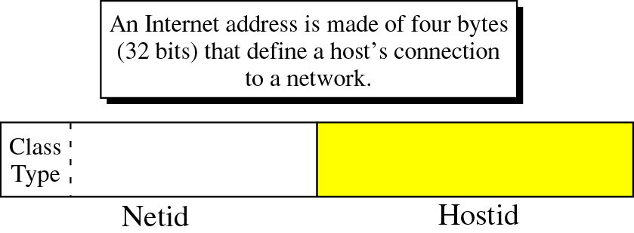
Classful Addressing
The address space is divided into five classes: A, B, C,D, and E.

Slide 9

The classes in binary and dotted-decimal notation

Slide 10
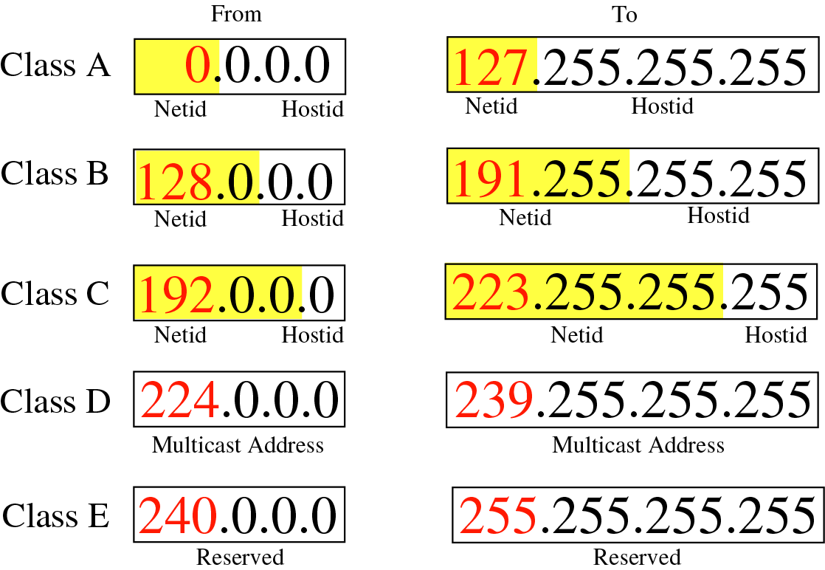
Address Range in classful IPv4 addressing

Slide 11
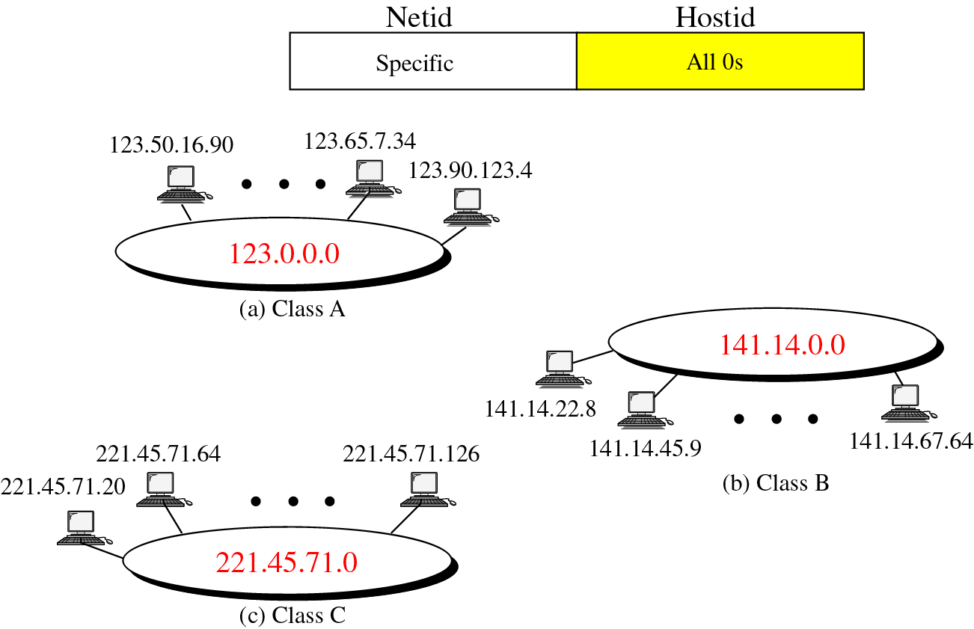
Network Address

Slide 12
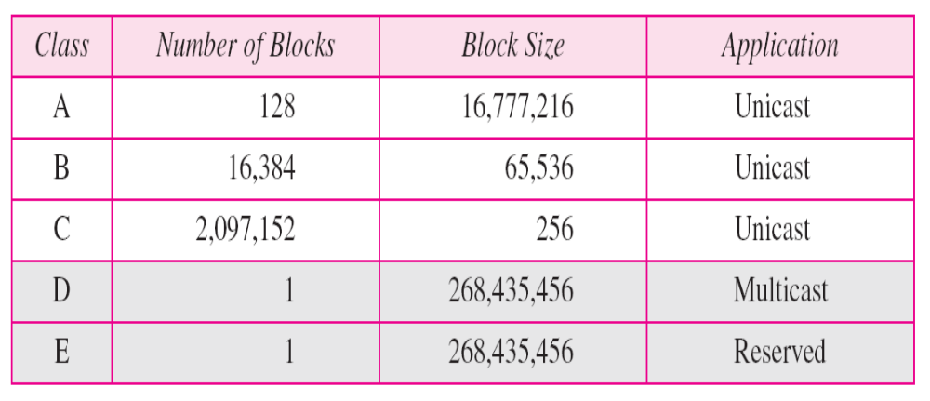
Number of blocks and block size in classful IPv4 addressing
In classful addressing, a large part of the available addresses were wasted.

Slide 13
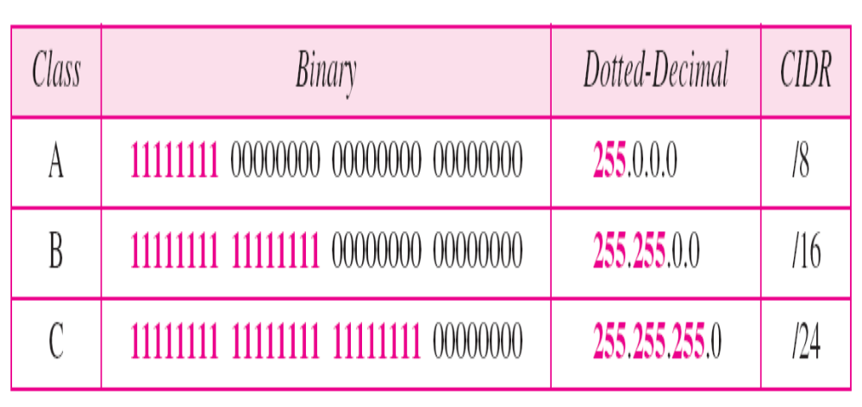
Default masks for classful addressing

Slide 14
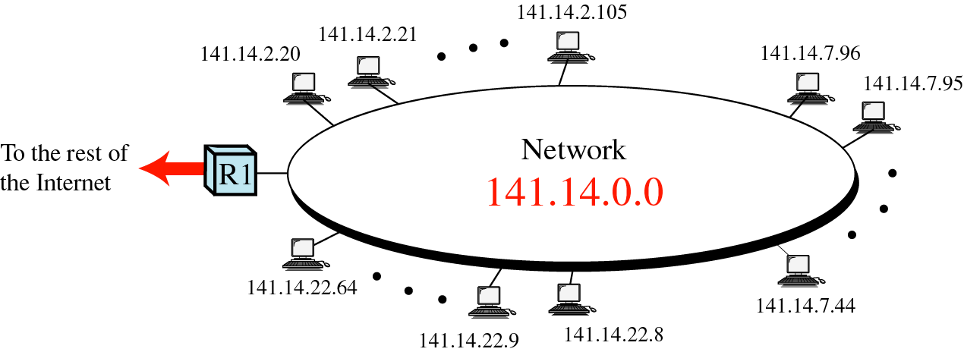
Subnetting

Slide 15
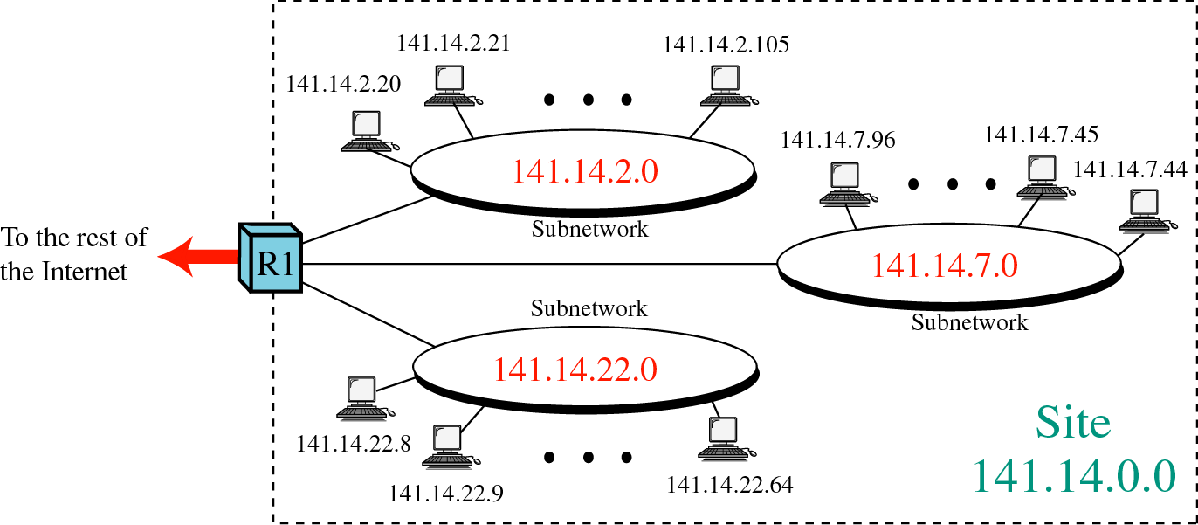

Slide 16
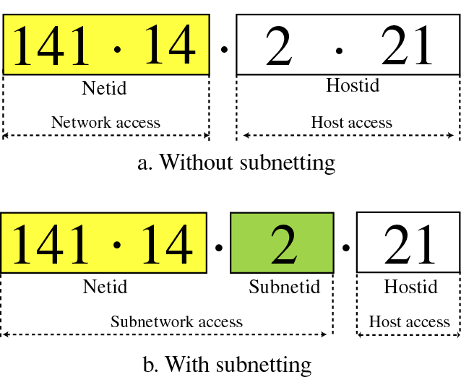

Slide 17
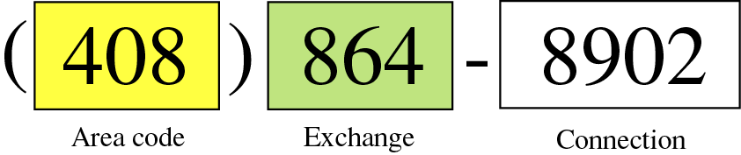

Slide 18
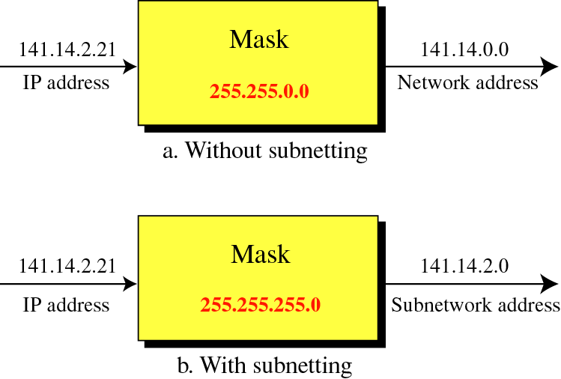

Slide 19
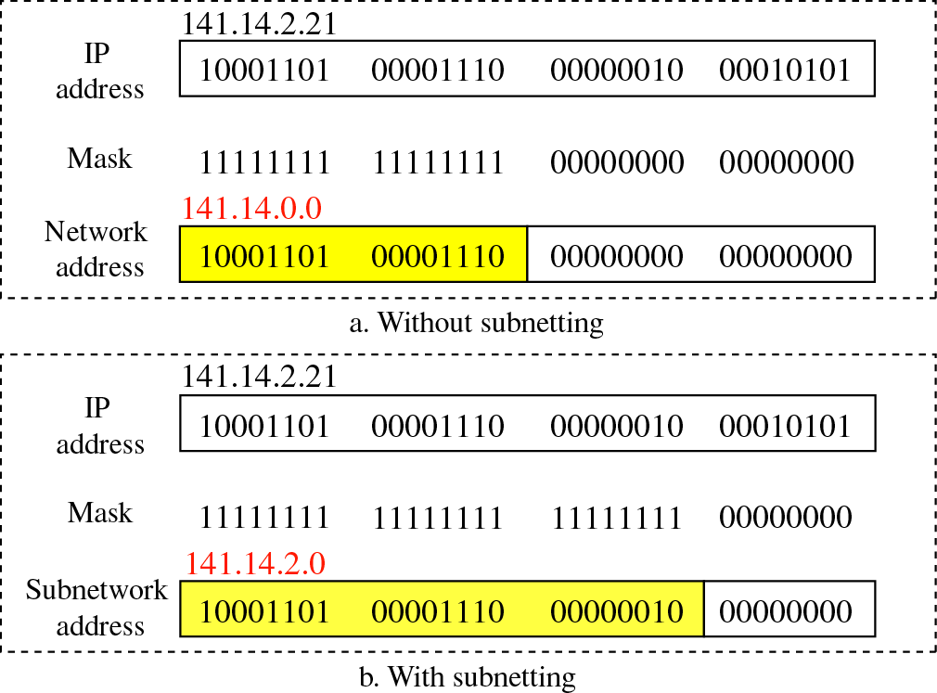

Slide 20

Network Address Translation (NAT)
Addresses for private networks

Slide 21

A NAT implementation

Slide 22

Addresses in a NAT

Slide 23
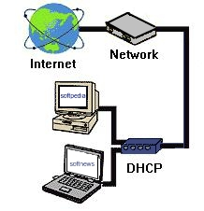
What is DHCP?
Dynamic Host Configuration Protocol
It is a method for assigning Internet Protocol (IP) addresses permanently or to individual computers in an organization’s network
DHCP lets a network administrator supervise and distribute IP addresses from a central point and automatically sends a new IP address when a computer is plugged into a different place in the network

Slide 24
Motivation for DHCP
Configuration parameters for network hosts
  IP address
  Router
  Subnet Mask
  Others..

Slide 25
Two types of IP Addresses
DHCP is used to assign IP addresses to hosts or workstations on the network
Two types of IP addresses:
  Static
    Is a number that is assigned to a computer by an Internet service provider (ISP) to be its permanent address on the Internet
  Dynamic
    The temporary IP address is called a dynamic IP address

Slide 26
Why is DHCP Important?
Important when it comes to adding a machine to a network
When computer requests an address, the administrator would have to manually configure the machine
  Mistakes are easily made
  Causes difficulty for both administrator as well as neighbors on the network
DHCP solves all the hassle of manually adding a machine to a network

Slide 27
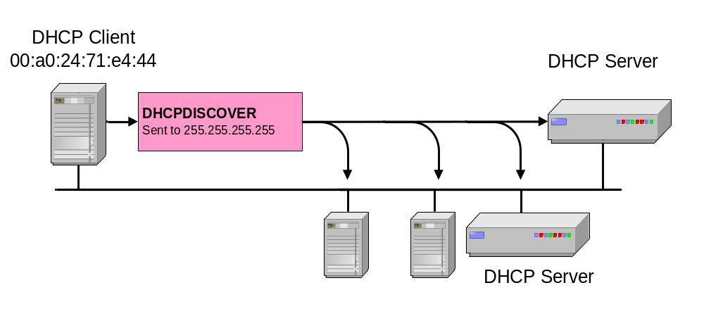
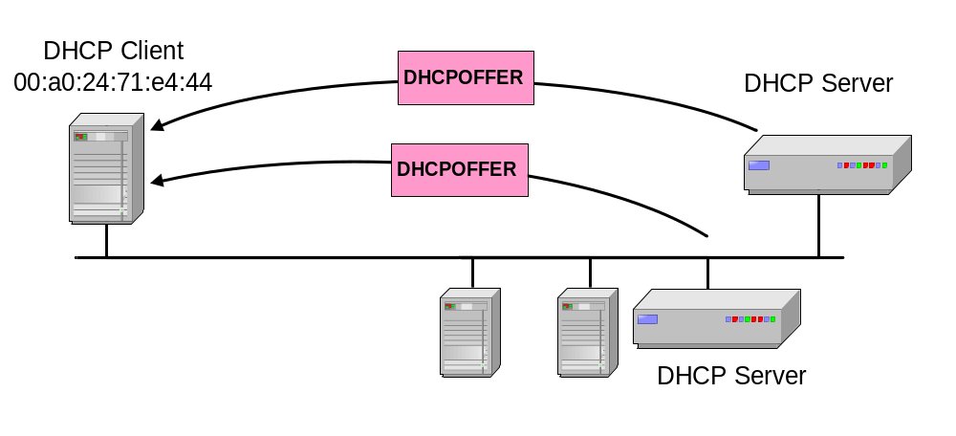
DHCP Operation
DCHP DISCOVER
128.12.11.1
DCHP OFFER
192.12.11.2

Slide 28
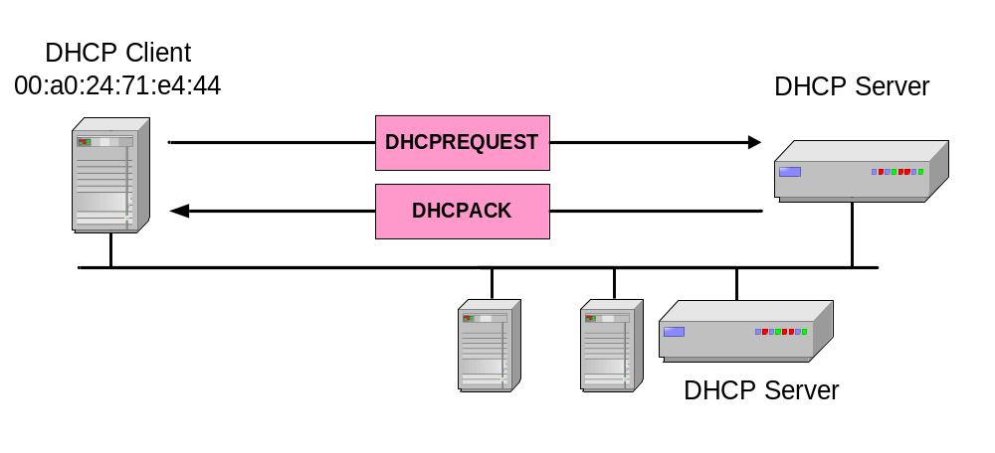
DHCP Operation
IP: 127.12.11.1
DCHP REQUEST and ACK
At this time, the DHCP client can start to use the IP address
IP: 127.12.11.1
Mask: 255.0.0.0
Gateway: 127.1.1.1
Lease: 60 Mins

Slide 29
Book: Data Communication and Networking by Behrouz Forouzan

